Slide 1
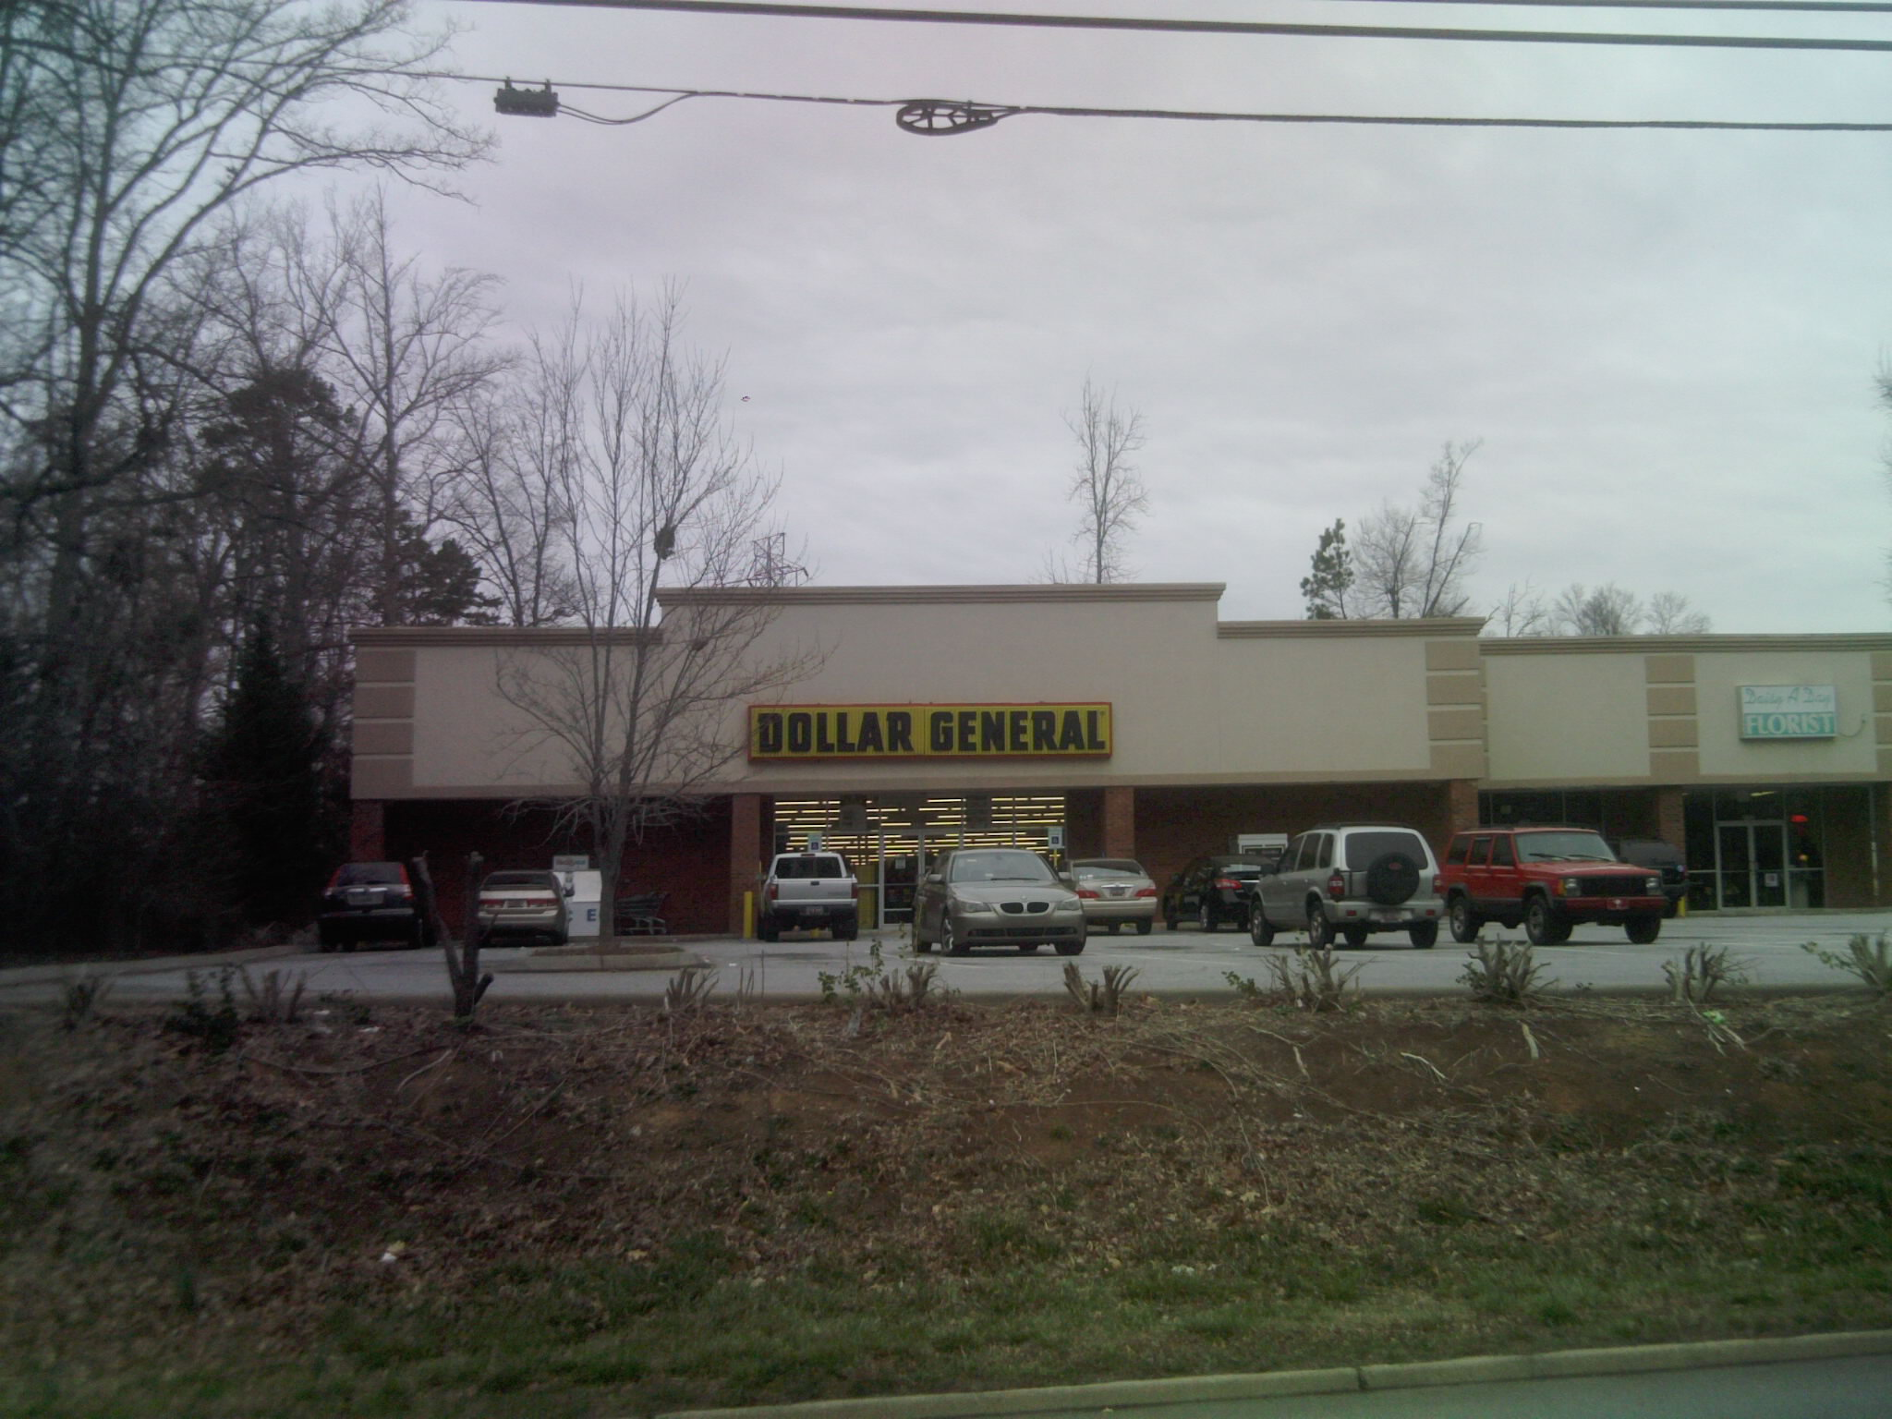
DG #11071 Spartanburg, SC

Slide 2
#11071 Base Rent $5,800 / month

Slide 3
#11071 is a small strip center

Slide 4
Google Image

